Slide 1
Unit -1
Mathematical Foundation
By
Dr P Muralidhar
Associate Professor
Department of Computer Science

Slide 2
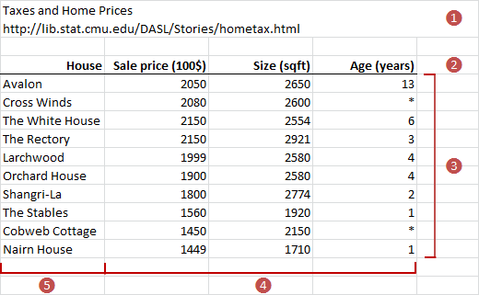
Machine Learning
Extracting valuable information from data.
Applying methodologies on datasets to extract meaningful information.
Data, model and learning

Slide 3
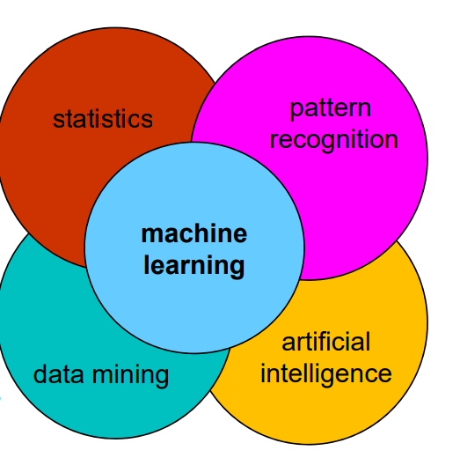
Machine Learning

Slide 4
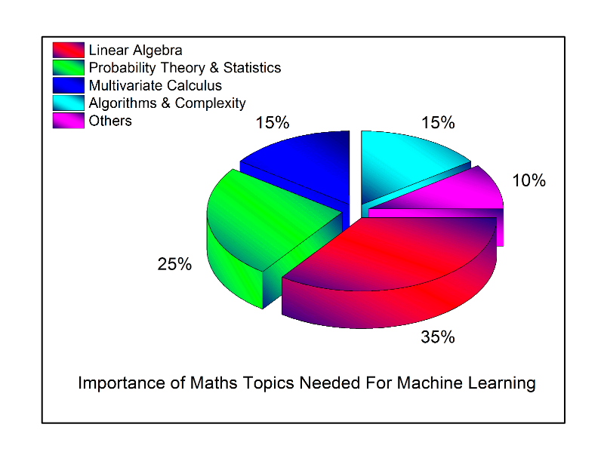

Slide 5
Linear Algebra
Vectors
Matrices
These are mainly to understand the machine learning algorithm operations.

Slide 6
Usage of Linear Algebra
Working with data such as tabular datasets and images
Working with data preparation, such as one hot encoding and dimensionality reduction
In deep Learning, natural language processing and recommended Systems

Slide 7
ML Models
A way that automatically find patterns and structures in data by optimizing the parameters of the model.
The model has to perform well on unseen data.
Note:
Data has already been appropriately converted into a numerical representation suitable for reading into a computer programs.

Slide 8
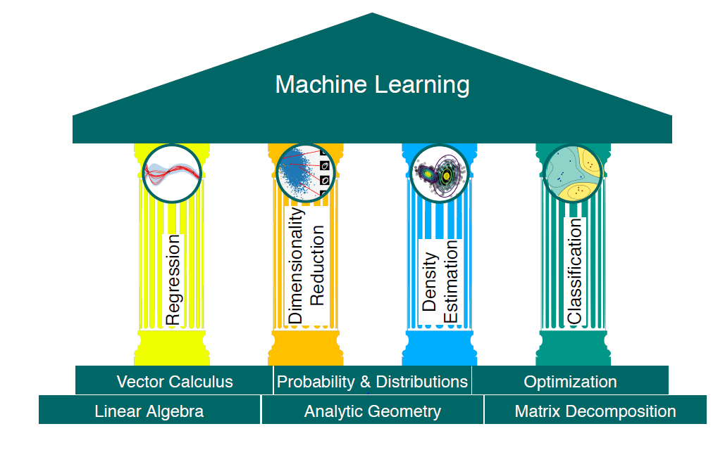

Slide 9
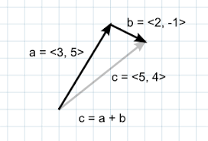
Linear Algebra
An approach is to construct a set of objects and set of rules to manipulate these objects, called Algebra.
Vectors are points in some finite dimensional space.
A Vector is simply a way simultaneously storing and handling two pieces of information
V= [x,y]
Matrices are points in multi dimensional space.

Slide 10
Data as Vectors/ Matrix
A vector as an arrow with a direction and magnitude ( a physical view)
Computer science view : An array of numbers
Representation of numerical data in tabular form is called Vectors.
Every person has height, weight and ages to treat data as 3-dimensional vectors (height, weight, age)
Ex:
Person=[175,79,45]

Slide 11
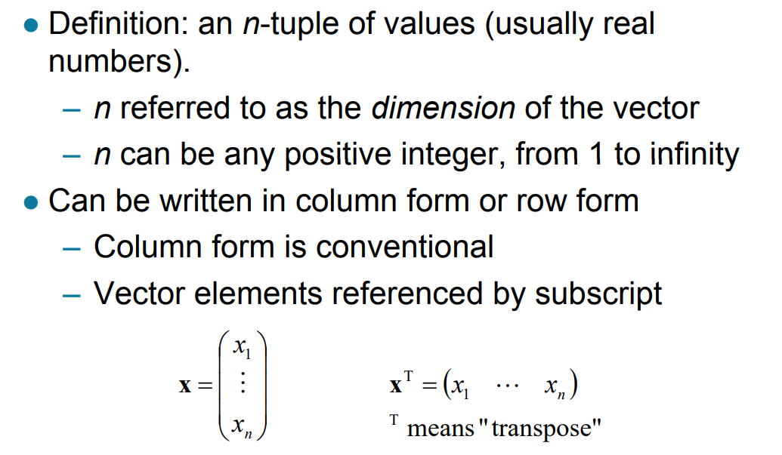
Vectors

Slide 12
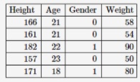
Student vector with four dimensional vector

Slide 13
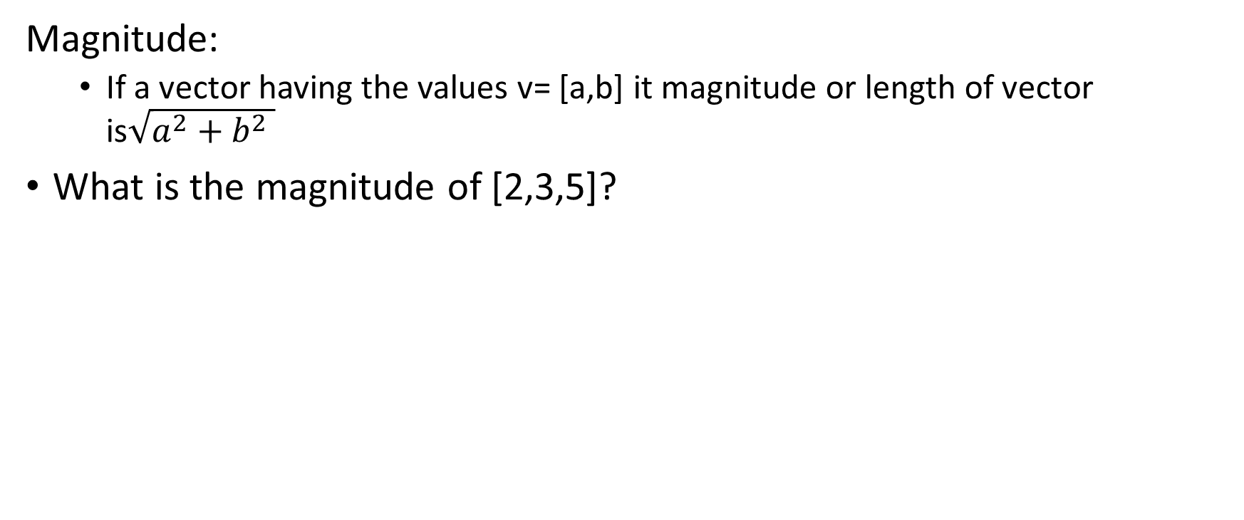
Operations on Vectors
Magnitude:
If a vector having the values v= [a,b] it magnitude or length of vector is$\sqrt{a^{2}+b^{2} }$
What is the magnitude of [2,3,5]?

Slide 14
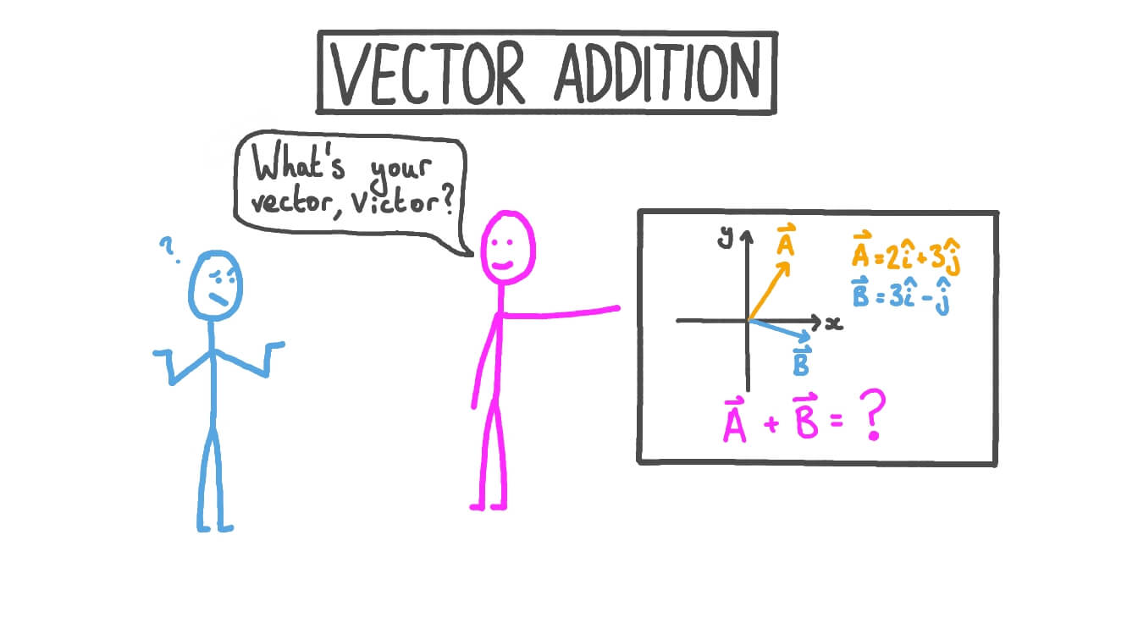
Vector addition

Slide 15
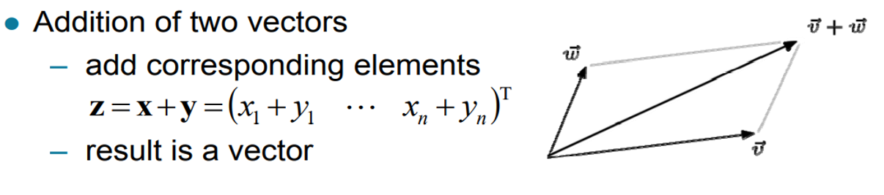
Vector Arithmetic

Slide 16
Vector Addition
a = [3, 5, -5, 8]
b = [4, 7, 9, -4]
print("Vector a = ", a)
print("Vector b = ", b)
# This is a 4 dimensional vector
# a list in python is a vector in linear algebra
# adding vectors
for i,j in zip(a,b):
sum.append(i + j)
a = [3, 5, -5, 8]
b = [4, 7, 9, -4]
print("Vector a = ", a)
print("Vector b = ", b)
# This is a 4 dimensional vector
# a list in python is a vector in linear algebra
# adding vectors
sum = []
for i in range(len(a)):
sum.append(a[i] + b[i])

Slide 17
Numpy
The fundamental package for scientific computing for Numerical packages
N-Dimensional Array: Fast and versatile, the NumPy vectorization, indexing, and broadcasting concepts are the de-facto standards of array computing today.
Numerical Computing Tool: NumPy offers comprehensive mathematical functions, random number generators, linear algebra routines, Fourier transforms, and more.
INTEROPERABLE: NumPy supports a wide range of hardware and computing platforms, and plays well with distributed, GPU, and sparse array libraries.
EASY TO USE: NumPy’s high level syntax makes it accessible and productive for programmers from any background or experience level.

Slide 18
Using Numpy
import numpy as np
a = np.array([3, 5, -5, 8])
b = np.array([4, 7, 9, -4])
print(a+b)
** array is method in numpy package

Slide 19
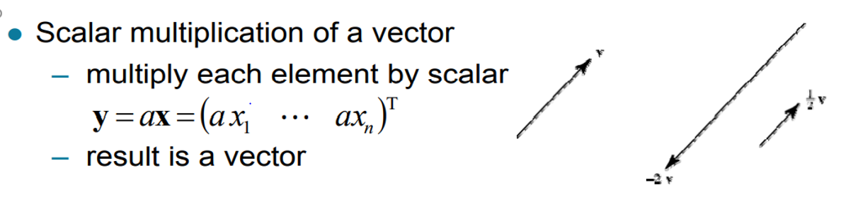
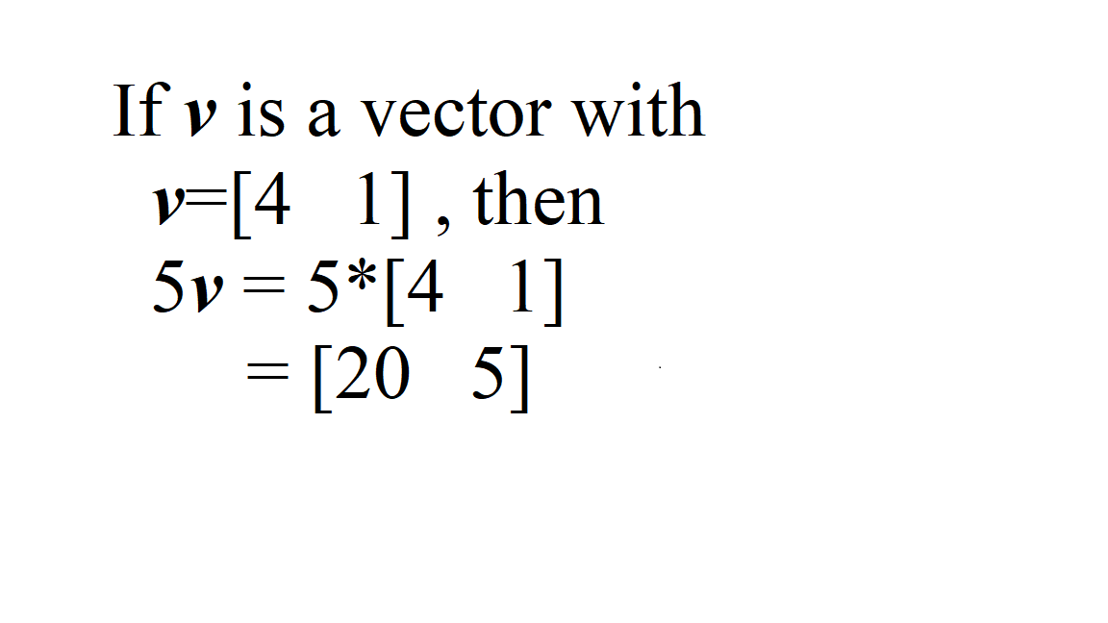
S = [22, 33, 45.6, 21.6, 51.8]
P = 2.45
Res=[]
for i in S:
Res.append(P*i)

Slide 20
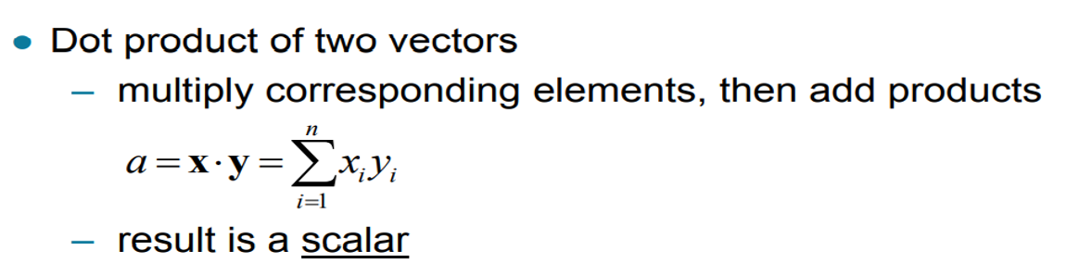
Vector Arithmetic
a = [3, 5, -5, 8]
b = [4, 7, 9, -4]
print("Vector a = ", a)
print("Vector b = ", b)
Sum=0
# This is a 4 dimensional vector
# a list in python is a vector in linear algebra
# adding vectors
for i,j in zip(a,b):
sum.append(i + j)
a = [3, 5, -5, 8]
b = [4, 7, 9, -4]
print("Vector a = ", a)
print("Vector b = ", b)
# This is a 4 dimensional vector
# a list in python is a vector in linear algebra
# adding vectors
sum = 0
for i in range(len(a)):
sum=sum+(a[i] * b[i])
x = np.array([4, 5])
y = np.array([7, 10])
print("Original vectors:")
print(x)
print(y)
print("Inner product of said vectors:") print(np.dot(x, y))

Slide 21
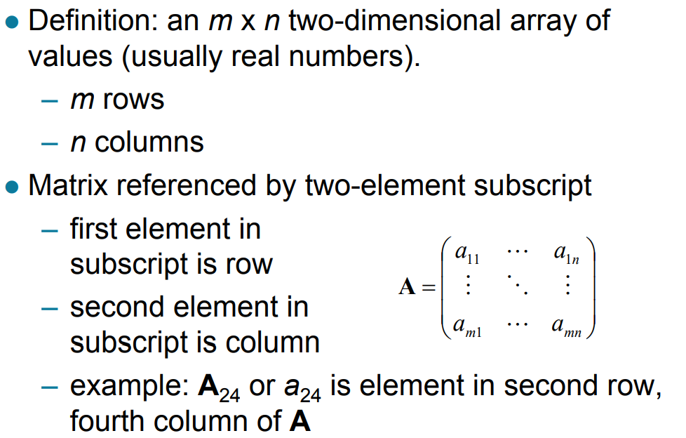
Matrices

Slide 22
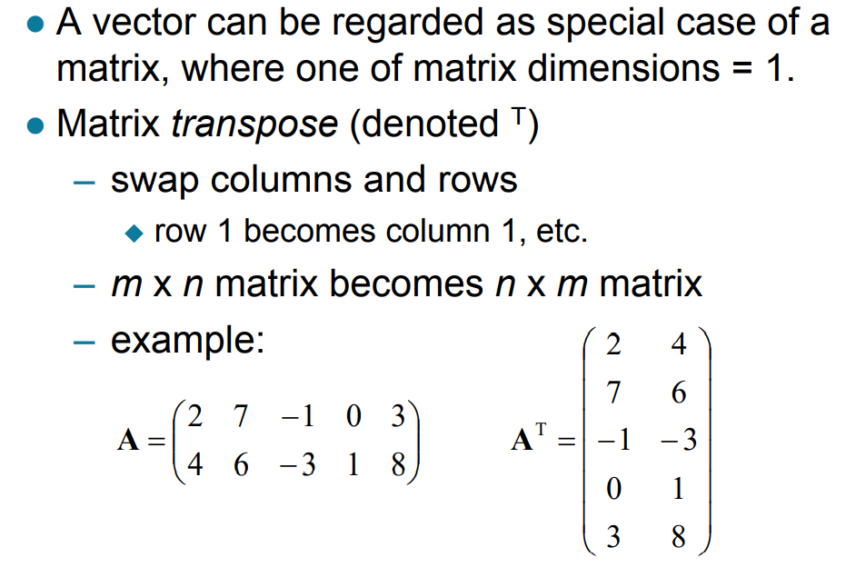
Matrices

Slide 23
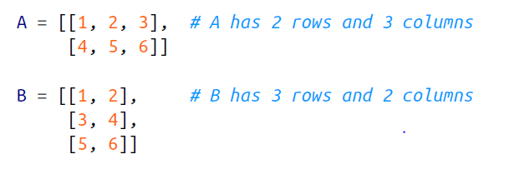
Example
def shape(A):
num_rows = len(A)
num_cols = len(A[0]) if A else 0
return num_rows, num_cols
Import numpy as np
A=np.array([[1,2,3],
[4,5,6]])
def shape(A):
A.shape

Slide 24
Real Example of Matrices
friendships = [(0, 1), (0, 2), (1, 2), (1, 3), (2, 3), (3, 4),
(4, 5), (5, 6), (5, 7), (6, 8), (7, 8), (8, 9)]
friendships = [[0, 1, 1, 0, 0, 0, 0, 0, 0, 0], # user 0
[1, 0, 1, 1, 0, 0, 0, 0, 0, 0], # user 1
[1, 1, 0, 1, 0, 0, 0, 0, 0, 0], # user 2
[0, 1, 1, 0, 1, 0, 0, 0, 0, 0], # user 3
[0, 0, 0, 1, 0, 1, 0, 0, 0, 0], # user 4
[0, 0, 0, 0, 1, 0, 1, 1, 0, 0], # user 5
[0, 0, 0, 0, 0, 1, 0, 0, 1, 0], # user 6
[0, 0, 0, 0, 0, 1, 0, 0, 1, 0], # user 7
[0, 0, 0, 0, 0, 0, 1, 1, 0, 1], # user 8
[0, 0, 0, 0, 0, 0, 0, 0, 1, 0]] # user 9

Slide 25
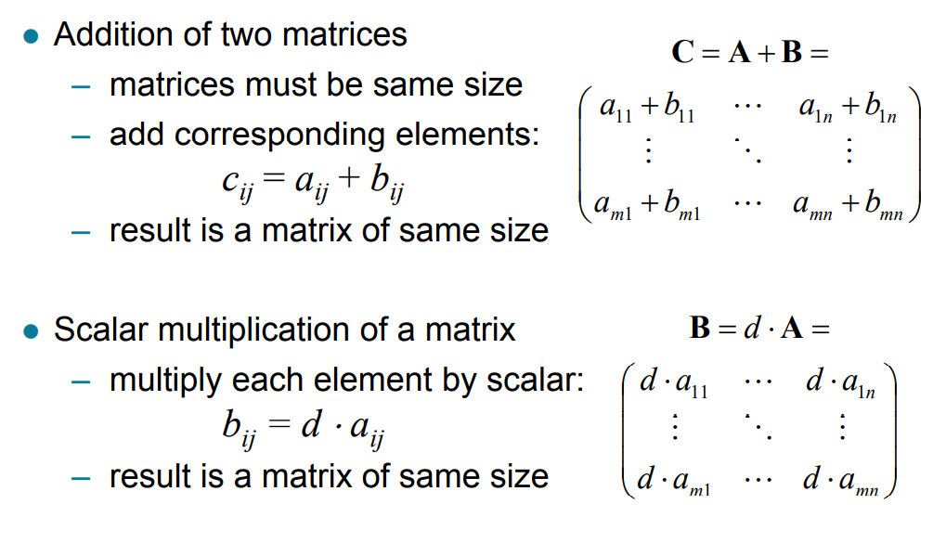
Matrix Operations

Slide 26
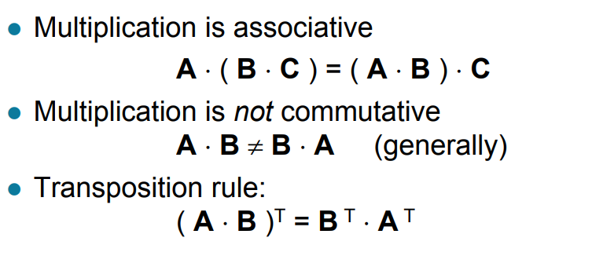
Matrix Operations

Slide 27
Statistics:
Statistics is the science of data. It involves collecting, classifying, summarizing, organizing, analyzing, and interpreting numerical information.
The process of examining what data means transforming data into useful information that can be shared.
Statistics are used to understand the status or state of quantitative data;

Slide 28
Examples
My son plays in his school cricket team, his batting average over the season was 28.9 runs.
Police estimate that 4,000 people took part in the protest march.
About 11,000,000 drivers will take to the roads during the coming Bank Holiday.
The average life of this type of tyre is between 20,000 and 25,000 miles
All four statements are concerned with the collection, organisation and analysis of data.

Slide 29
Frequency Tables
The below following data are the heights (to the nearest tenth of a centimetre) of 30 students studying engineering statistics.
150.2 167.2 176.2 160.1 151.8 166.3 162.3 167.4 178.3 181.2 175.7 161.1 179.3 168.9 164.8 165.0 177.1 183.2 172.1 180.2 168.2 173.8 164.3 176.8 184.2 170.9 172.2 168.5 169.8 176.7

Slide 30
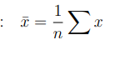
Measures of Central tendency: i) Mean
If we take a set of numbers x1, x2, . . . , xn, its mean value is defined as:
mean = (x1 + x2+x3 + . . . .. +xn)/ n
def mean(x):
return sum(x) / len(x)
num_friends=[10,20,30]
mean(num_friends)

Slide 31
ii) median: The central value of the data
def median(v):
"""finds the 'middle-most' value of v"""
n = len(v)
sorted_v = sorted(v)
midpoint = n // 2
if n % 2 == 1:
# if odd, return the middle value
return sorted_v[midpoint]
else:
# if even, return the average of the middle values
lo = midpoint - 1
hi = midpoint
return (sorted_v[lo] + sorted_v[hi]) / 2

Slide 32
Mode: the most frequently occurring value in the data set.
def mode(x):
"""returns a list, might be more than one mode"""
counts = Counter(x)
max_count = max(counts.values())
return [x_i for x_i, count in counts.iteritems() if count == max_count]

Slide 33
Quantile:represents the value less than which a certain percentile of the data lies.
def quantile(x, p):
"""returns the pth-percentile value in x"""
p_index = int(p * len(x))
return sorted(x)[p_index]

Slide 34
Dispersion:measures of how spread out our data
def data_range(x):
return max(x) - min(x)
Measure of Dispersion by Variance
def de_mean(x):
"""translate x by subtracting its mean (so the result has mean 0)""“
x_bar = mean(x)
return [x_i - x_bar for x_i in x]
def variance(x):
"""assumes x has at least two elements"""
n = len(x)
deviations = de_mean(x)
return sum_of_squares(deviations) / (n - 1)

Slide 35
def standard_deviation(x):
return math.sqrt(variance(x))
First quartile
Second quartile
Third quartile
Fourth quartile
Interquartile

Slide 36
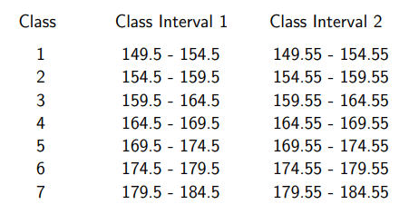
Class Interval
Class Class Interval
1 150 - 155
2 155 - 160
3 160 - 165
4 165 - 170
5 170 - 175
6 175 - 180
7 180 - 185

Slide 37
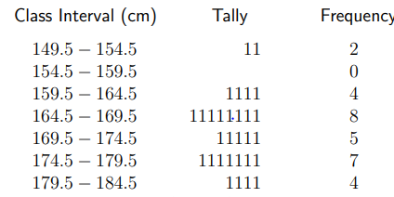
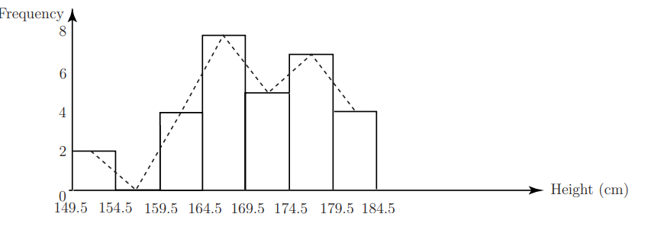
Histogram
Pictorical representation of
Frequency distribution
Frequency Polygon: joining the m midpoints of the blocks of h histogram

Slide 38
Pandas
Pandas is a fast, powerful, flexible and easy to use open source data analysis and manipulation tool.
Pandas Data Structures (series,tabular, multidimensional ) and time series data.
One dimensional data -> Series
Two dimensional data -> DataFrames
Multidimensional data -> Panel
Import pandas -> import pandas as pd

Slide 39
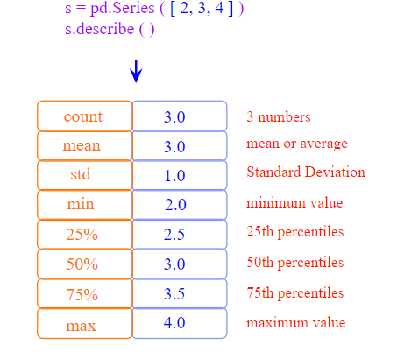
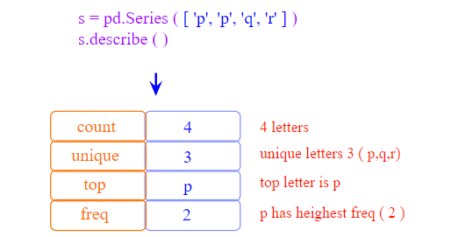
Describe method in pandas
describe() is used to view some basic statistical details like percentile, mean, std etc. of a data frame or a series of numeric values.

Slide 40
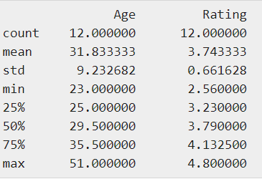
import pandas as pd
import numpy as np
#Create a Dictionary of series
d = {'Name':pd.Series(['Tom','James','Ricky','Vin','Steve','Smith','Jack',
'Lee','David','Gasper','Betina','Andres']),
'Age':pd.Series([25,26,25,23,30,29,23,34,40,30,51,46]), 'Rating':pd.Series([4.23,3.24,3.98,2.56,3.20,4.6,3.8,3.78,2.98,4.80,4.10,3.65])
}
#Create a DataFrame
df = pd.DataFrame(d)
print (df.describe())

Slide 41
Example of Pandas
host_names = ['Maarten','Fronk & Lieve','Elke','Francis','Kristof',
'Liesbet','Chloé','Klara','Maarten','Kristina']
listing_count = [1, 7, 1, 2, 1, 1, 1, 1, 1, 1]
review_count = [25, np.nan, 4, 59, 3, 89, 3, 2, 7, np.nan]
accommodates = [2, 2, 3, 2, 2, 4, 2, 5, 4, 2]
year=[2014, 2012, 2013, 2012, 2012, 2011, 2014, 2014, 2012, 2014]
data = {'joining_year': year, 'listing_count': listing_count,
'review_count': review_count,'accommodates': accommodates,
'host_names' : host_names}
host_df = pd.DataFrame(data)
host_df

Slide 42
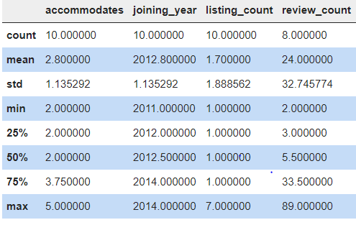
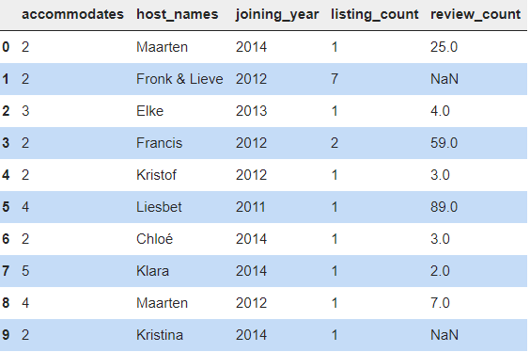
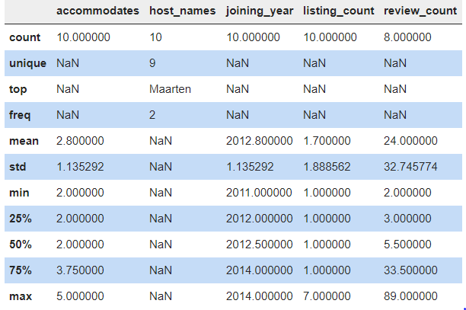
host_df.describe()
host_df.describe(include='all')

Slide 43
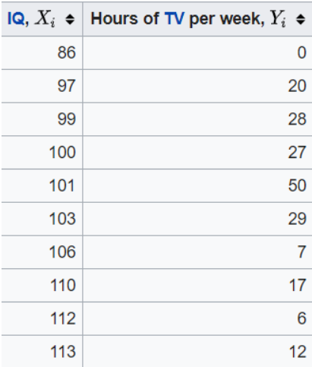
Correlation

Slide 44
Correlation
Association - more precisely it is a measure of the extent to which two variables are related.
There are three possible results :
1. Positive Correlation
2. Negative Correlation
3. No correlation
A positive correlation is a relationship between two variables in which both variables move in the same direction. Therefore, when one variable increases as the other variable increases
Example: Knowledge & Salary, demand vs cost

Slide 45
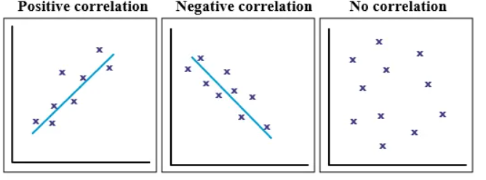
A negative correlation is a relationship between two variables in which an increase in one variable is associated with a decrease in the other.
Example: Height vs temperature, height vs oxygen availability
A zero correlation exists when there is no relationship between two variables

Slide 46
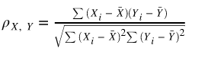
def covariance(x, y):
n = len(x)
return dot(de_mean(x), de_mean(y)) / (n - 1)
def Correlation(X,Y):
cov=covariance(X,Y)
std_x=standard_deviation(X)
std_y=standard_deviation(Y)
return cov/(std_x*std_y)
Correlation can be expressed numerically as a coefficient, ranging from -1 to +1.
A correlation of –1 indicates a perfect negative correlation, meaning that as one variable goes up, the other goes down. A correlation of +1 indicates a perfect positive correlation, meaning that as one variable goes up, the other goes up.
Assume test is dataframe for given table in slide 43
test[‘X’].corr(test[‘y’])

Slide 47
Causation
if x and y are strongly correlated, that might mean that x causes y, that y causes x, that each causes the other
Assume purchase of icecream is more in in hot summer. When the temperature increases icecreams sales are increasing.
Sales of icecream is increases with hot whether

Slide 48
Simpson’s Paradox
A trend or result that is present when data is put into groups that reverses or disappears when the data is combined.
An effect that occurs when the marginal association between two categorical variables is qualitatively different from the partial association between the same two variables after controlling for one or more other variables.

Slide 49
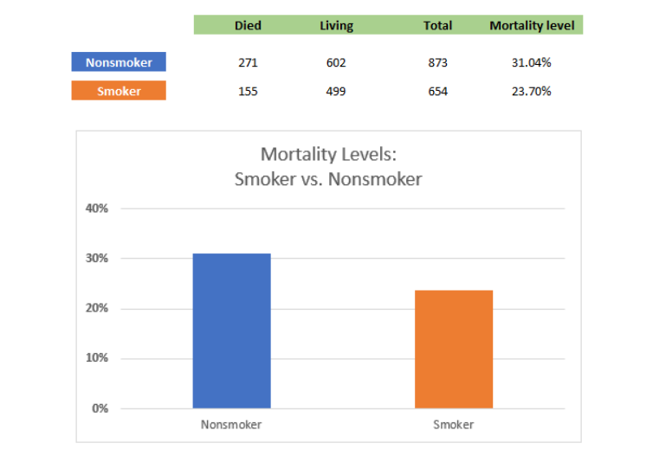

Slide 50
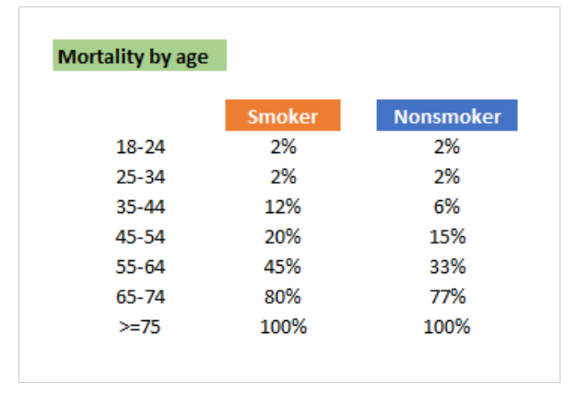

Slide 51
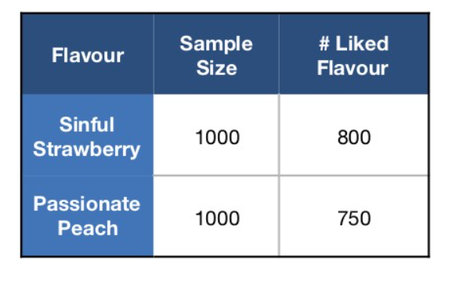
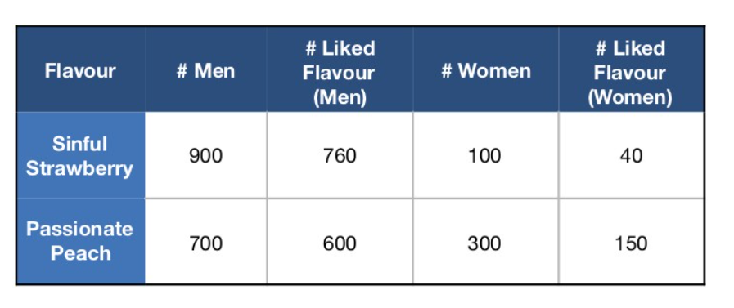
Example 2

Slide 52
Two Phenomenon's
An ordinary variable thought to be insightful exists and needs to be cross tabulated with the “what we are trying to explain” variable. This variable is age in the smoker example and income in the marketing illustration.
The sample selected from each of these categories (age groupings) are substantially different in size.

Slide 53
Probability Theory
The best predictions can be made with the knowledge of the concept of Probability Theory
Mathematical Framework with concepts for modeling predictions of unpredictable events.

Slide 54
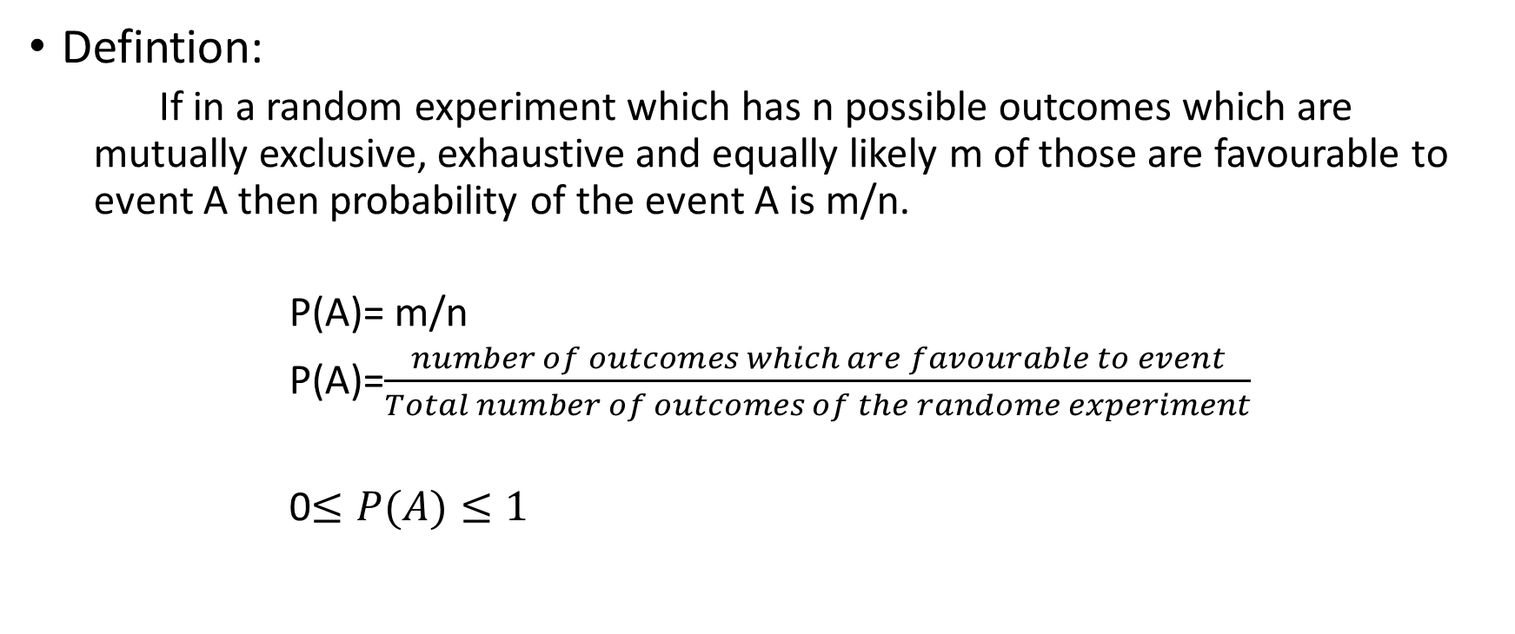
Probability
Defintion:
If in a random experiment which has n possible outcomes which are mutually exclusive, exhaustive and equally likely m of those are favourable to event A then probability of the event A is m/n.
P(A)= m/n
P(A)=$\frac{number of outcomes which are favourable to event}{Total number of outcomes of the randome experiment}$
0$≤P(A)≤1$

Slide 55
Mutually Exclusive Events: Two events are mutually exclusive if they cannot occur simultaneously.
Ex: A student chosing second language as either Telugu or Hindi
Exhaustive Events: Several events are said to form an exhaustive set if one of them must necessarily occur. The group of all possible elementary events constitute an Exhaustive set.
Equally Likely Events: Two events are equally likely if they have equal chances to occur.

Slide 56
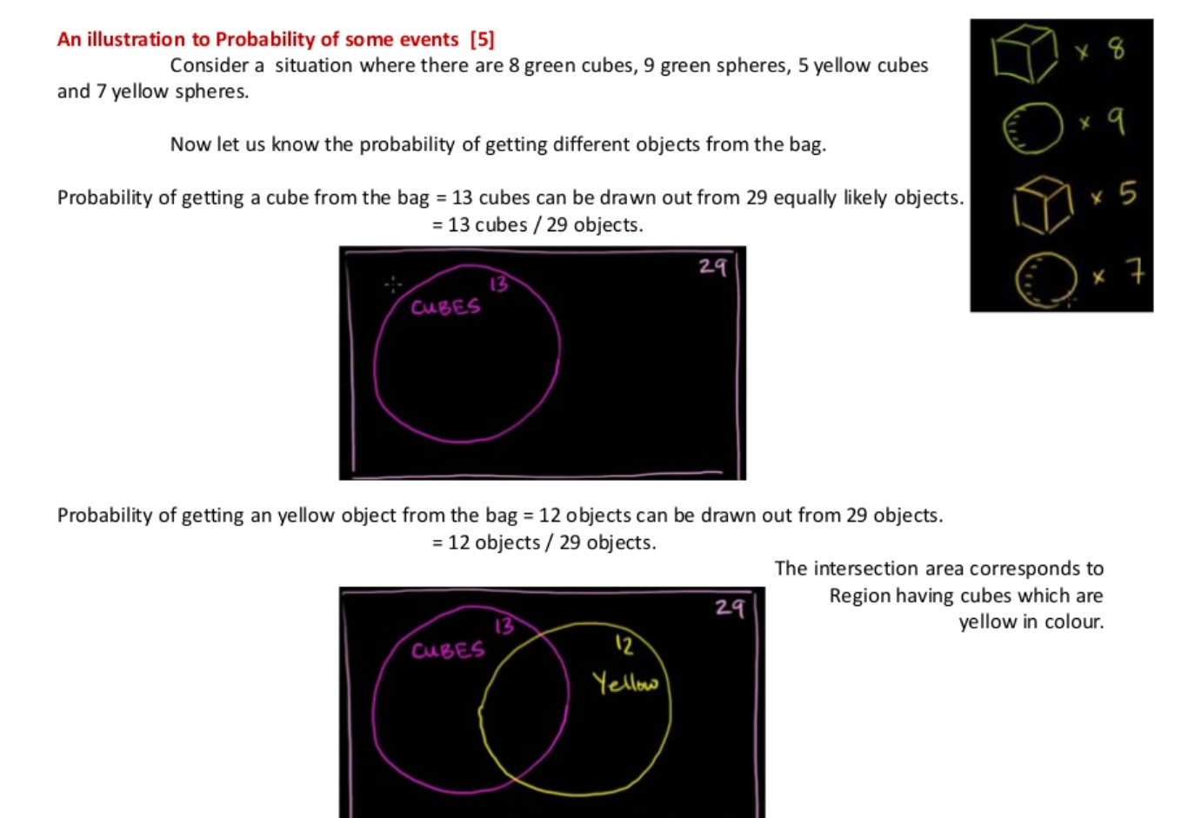

Slide 57
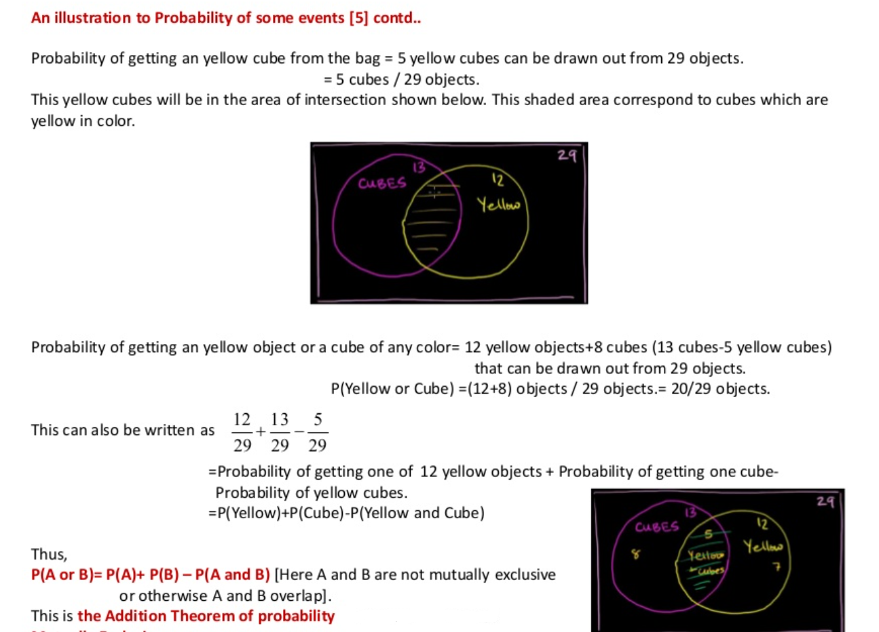

Slide 58
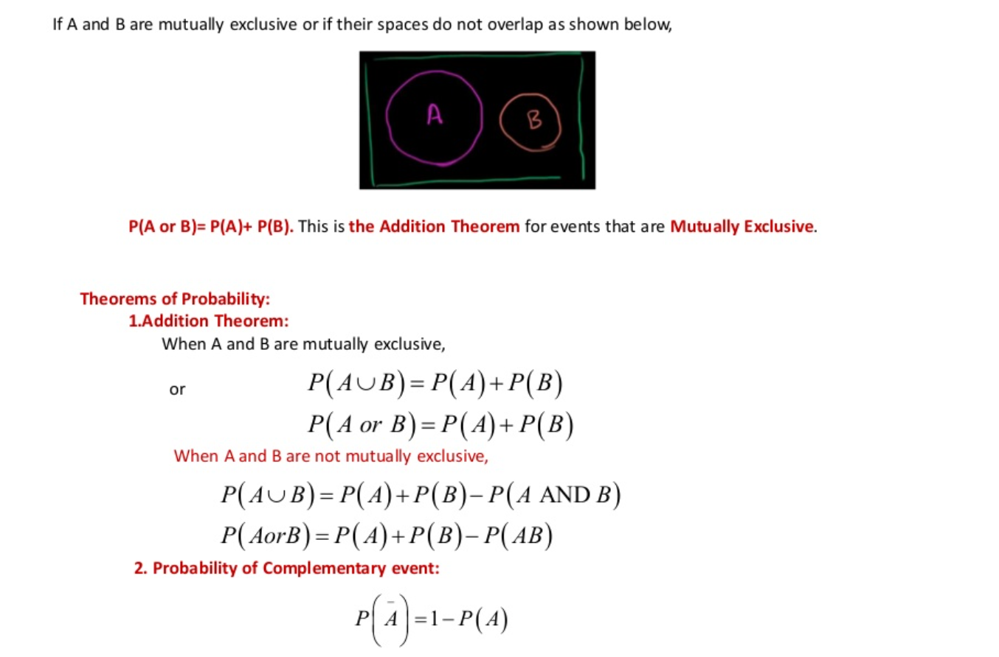

Slide 59
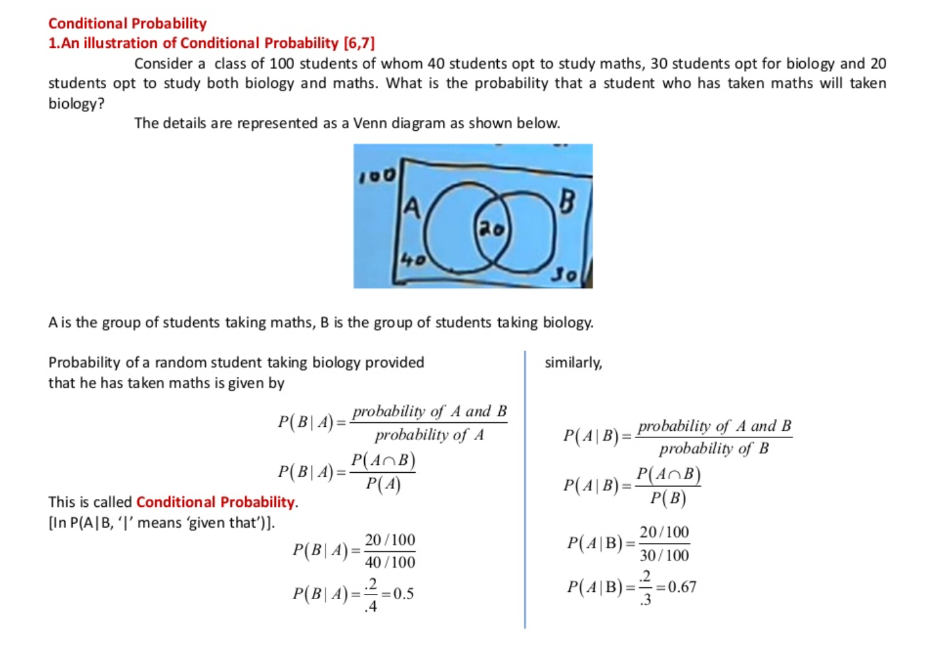

Slide 60
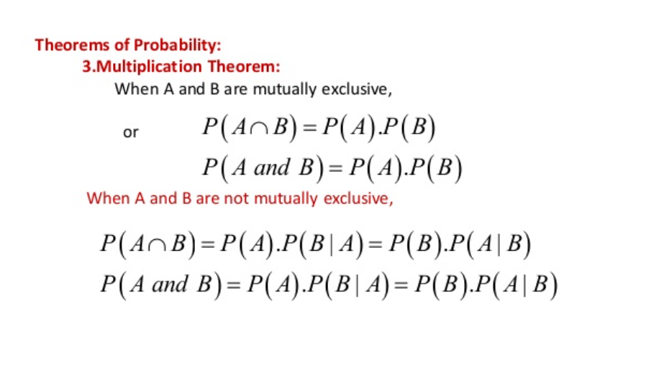

Slide 61
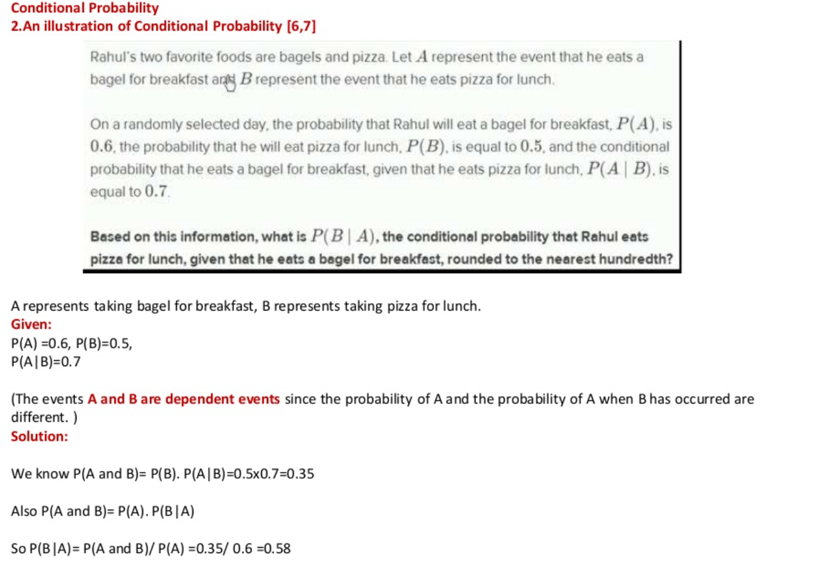

Slide 62
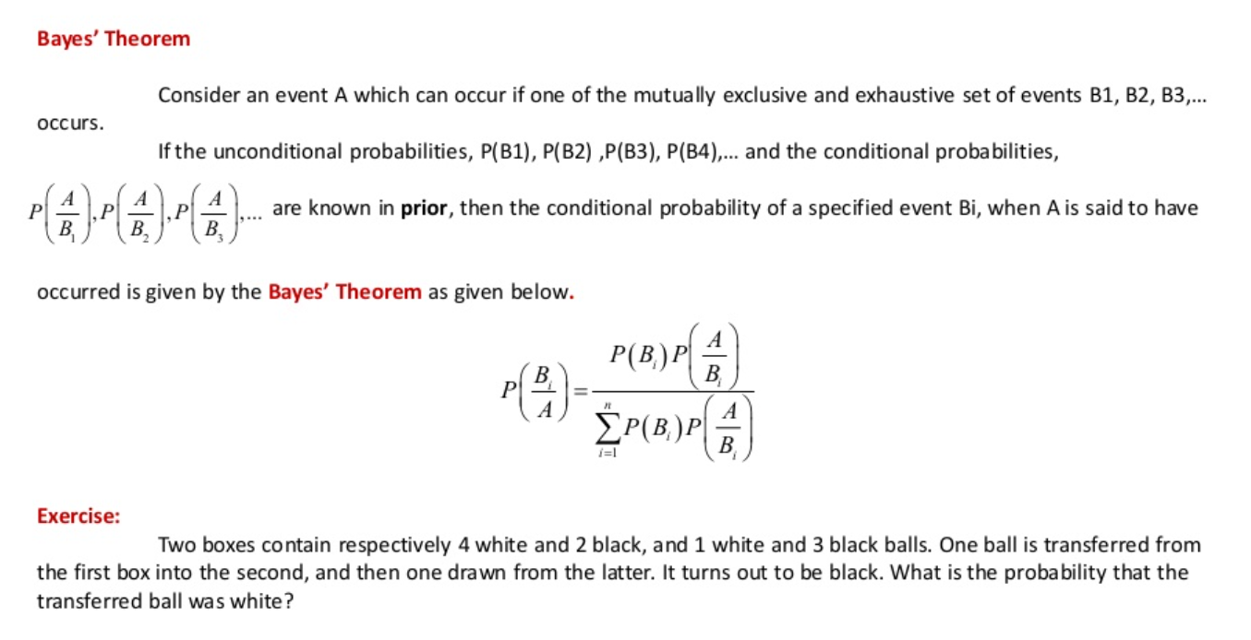

Slide 63
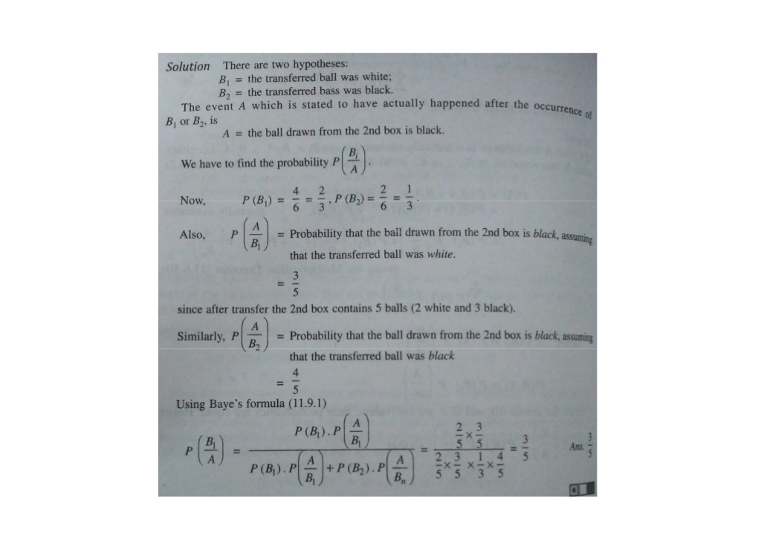
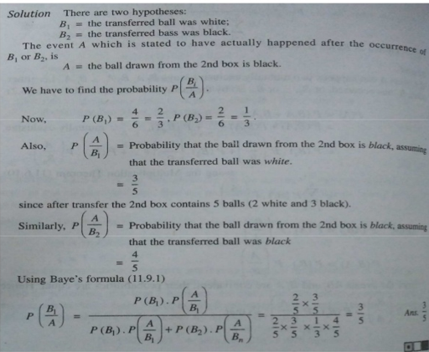

Slide 64
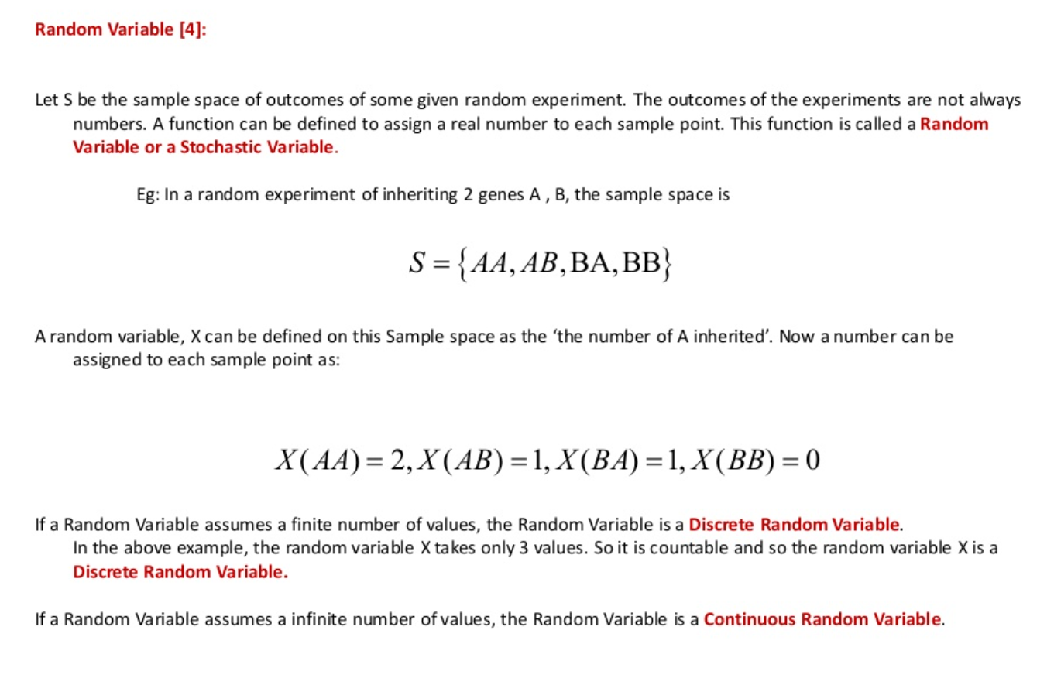

Slide 65
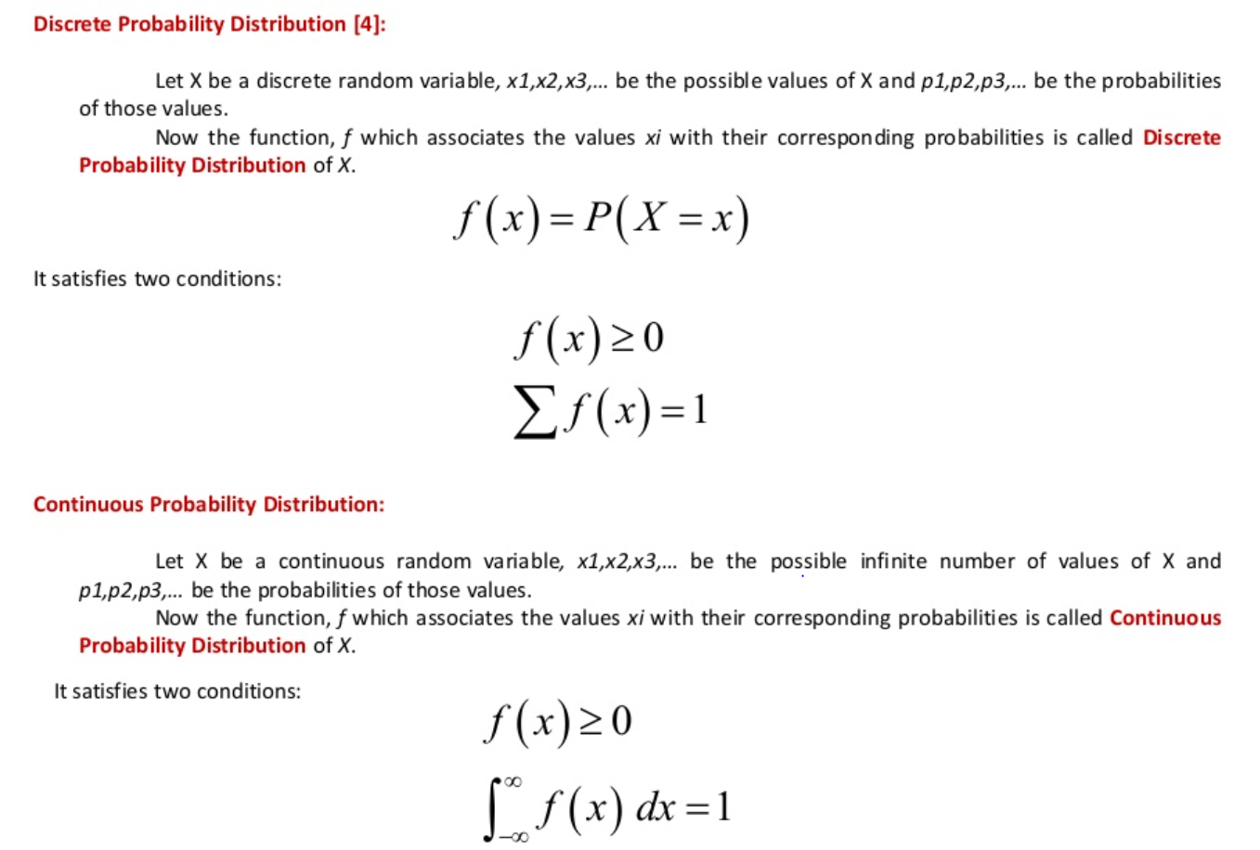
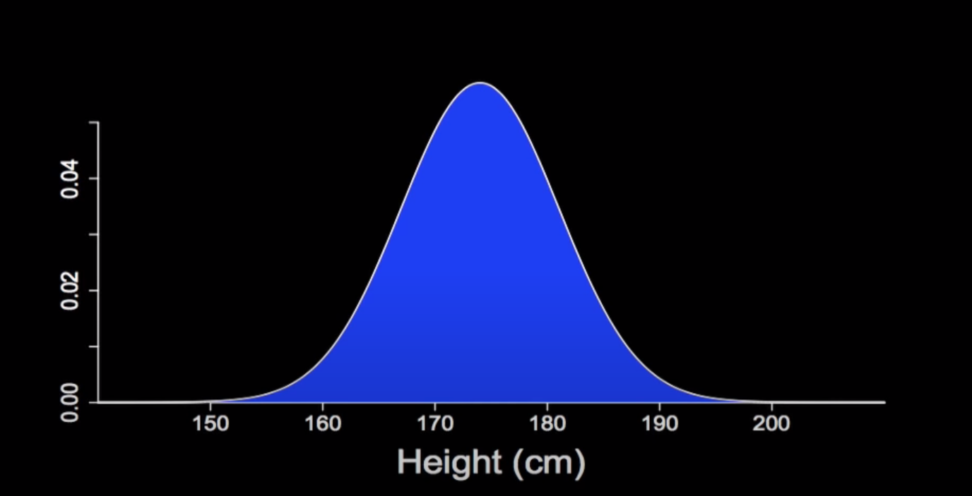
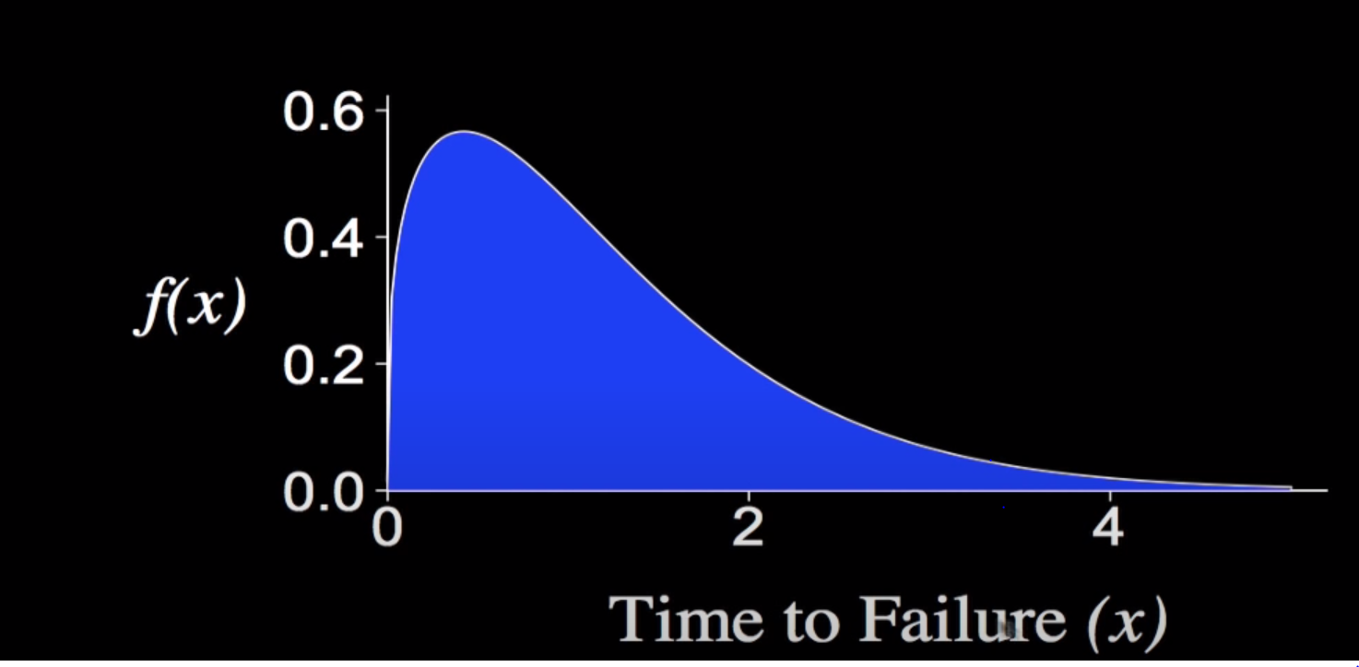

Slide 66
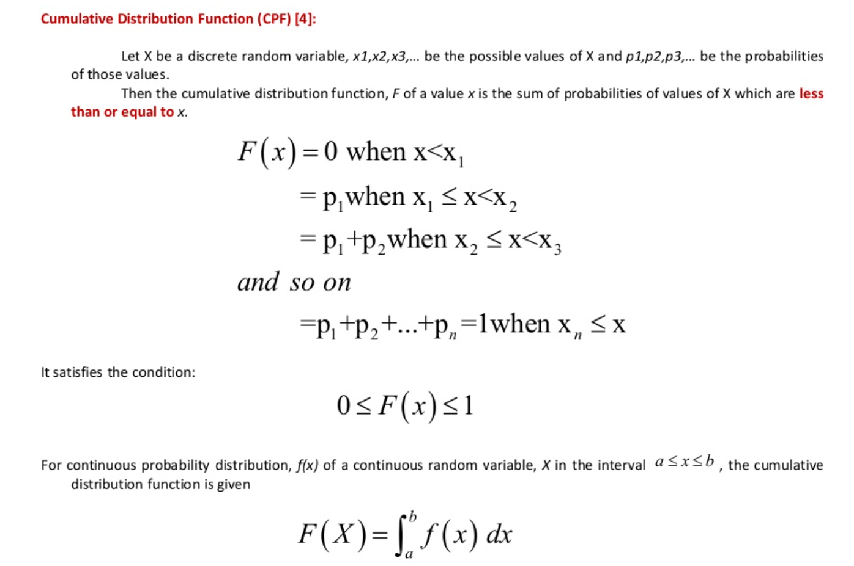

Slide 67


Slide 68

Normal Distribution

Slide 69




Slide 70


Slide 71


Slide 72


Slide 73


Slide 74


Standard normal distribution

Slide 75


Slide 76


Slide 77


Slide 78


For example, a population may be all students in our college and the sample may be a specific group of students .
he population is a collection of objects that we want to study/test.

Slide 79


Central Limit theorem

Slide 80

The central limit theorem (CLT) tells us no matter what the original parent distribution, sampling distribution of X¯ is typically normal when n ≥ 30.

Slide 81


Slide 82

Hypothesis and Statistical Inferences
The main purpose of Statistics inference is to make an accurate conclusion using a limited sample about a greater population.
hypothesis testing uses point estimate to decide which of two hypotheses (guesses) about parameter is correct.

Slide 83

Null Hypothesis is default position or default mean of population
Alternate hypothesis is which we are comparing

Slide 84
Steps to Perform Hypothesis Testing
Finding Null Hypothesis and Alternative Hypthesis
Specifying Confidence interval or Level of Significance
Apply z test or t test
Looking into z table or t table for both obtained value and p value
Proving Null Hypothesis is rejected or Accepted
t-calc > t-table => REJECT HO => p-value < 0.05
t-calc < t-table => FAIL TO REJECT HO => p-value > 0.05

Slide 85


Slide 86
Old System Vs New System
old System
In Preparing 100 screws
screws probability
95/100 -> 0.49
94/100 -> 0.32
93/100-> 0.10
92/100-> 0.5
New System
In Preparing 100 screws claims
screws probability
95/100 -> 0.55
sample 100 -> 92

Slide 87


Slide 88


Slide 89

In a battery factory, 8% of all batteries made are assumed to be defective. Technical trouble with production line, however, has raised concern percent defective has increased in past few weeks. Of n = 600 batteries chosen at random, 70 /600 ths of them are found to be defective. Does data support concern about defective batteries at α = 0.05?

Slide 90


Slide 91


Slide 92


Slide 93

Level of Significance
The significance level, also denoted as alpha or α, is a measure of the strength of the evidence that must be present in your sample before you will reject the null hypothesis.
The researcher determines the significance level before conducting the experiment.
The significance level is the probability of rejecting the null hypothesis when it is true. For example, a significance level of 0.05 indicates a 5% risk of concluding that a difference exists when there is no actual difference.
Lower significance levels indicate that you require stronger evidence before you will reject the null hypothesis.

Slide 94

Alpha error is because of sample error, your calculated p-value that is less than significance level, you get excited because your results are statistically significant.
your calculated p-value is greater than significance level, your results are not statistically significant.
Beta error is because of small sample size, high data variability

Slide 95


Slide 96


Slide 97




Tests

Slide 98
P-hacking
The process can be abused to create misleading results. This is a technique known colloquially as ‘p-hacking’.
It is a misuse of data analysis to find patterns in data that can be presented as statistically significant when in fact there is no real underlying effect.

Slide 99
T-Test
Participation in therapy sessions.
Contract to attend 10 sessions
μ = 4 6.
Sample: 6, 6, 12, 7, 8

Slide 100


Slide 101


Slide 102


Slide 103


Slide 104


Slide 105


Z-test
A school claimed that the students’ study that is more intelligent than the average school. On calculating the IQ scores of 50 students, the average turns out to be 110. The mean of the population IQ is 100 and the standard deviation is 15. State whether the claim of principal is right or not at a 5% significance level.

Slide 106

State the level of significance. Here, our level of significance given in this question (∝ =0.05), if not given then we take ∝=0.05.
Here 4.71 >1.645, so we reject the null hypothesis. If z-test statistics is less than z-score, then we will not reject the null hypothesis.

Slide 107

F-Test

Slide 108


Slide 109


Slide 110


Slide 111



ANOVA
ANOVA is a parametric statistical technique that helps in finding out if there is a significant difference between the mean of three or more groups.
Steps
1. Define the null and alternative hypothesis.
H0 -> μ1 = μ2 = μ3 (where μ = mean)
Ha -> At least one difference among the means.
2. Find the degree of freedom between and within the groups.

Slide 112


It is defined as the ratio of the variance between samples to variance within samples. It is obtained while performing ANOVA test

Slide 113



Slide 114


Slide 115


Slide 116


Slide 117




Slide 118



Slide 119


Slide 120



Slide 121


Slide 122


Slide 123


Slide 124


Slide 125



Slide 126

Bayesian Statistical Inference
Bayes Theorem:

Slide 127





Slide 128




Slide 129


Slide 130



Slide 131


Slide 132



